Slide 1


Andrew Ross
Mantas Drungys
Srikkanth Ramesh
Nanjunda Reddy
Murli Krishna
Manish Bagwari

Slide 2
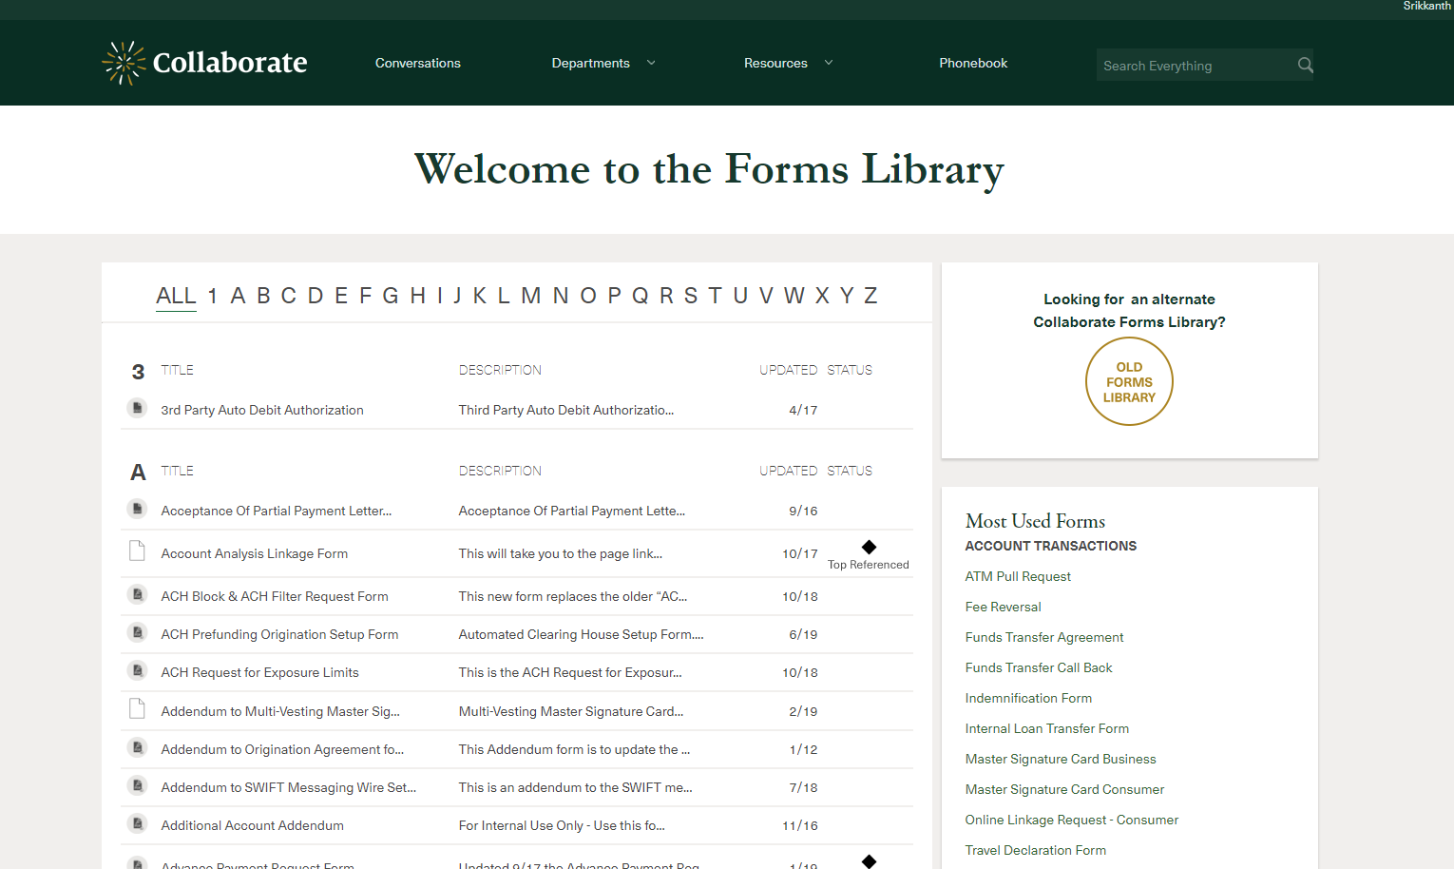
AutoDocs - Problem Statement
15+ Departments using Collaborate Forms
Over 500 Forms require manual entry. Very time Consuming!

Slide 3

AutoDocs - Solution
Automate the process of collecting data by using existing databases
Dynamically pre-fill the information in pre-selected templates
Show fields that need attention
Ability to save, share and print the populated documents
Categorize Documents & Provision Access if document is restricted

Slide 4

AutoDocs - Business Impact
Average time savings per document ~ 5 to 30 minutes
Number of daily document populations ~ 250 to 1,000
Time saved in a month ~ 400 to 1600+ hours
Annual Savings in Person Hours - $250,000 to ?

Slide 5
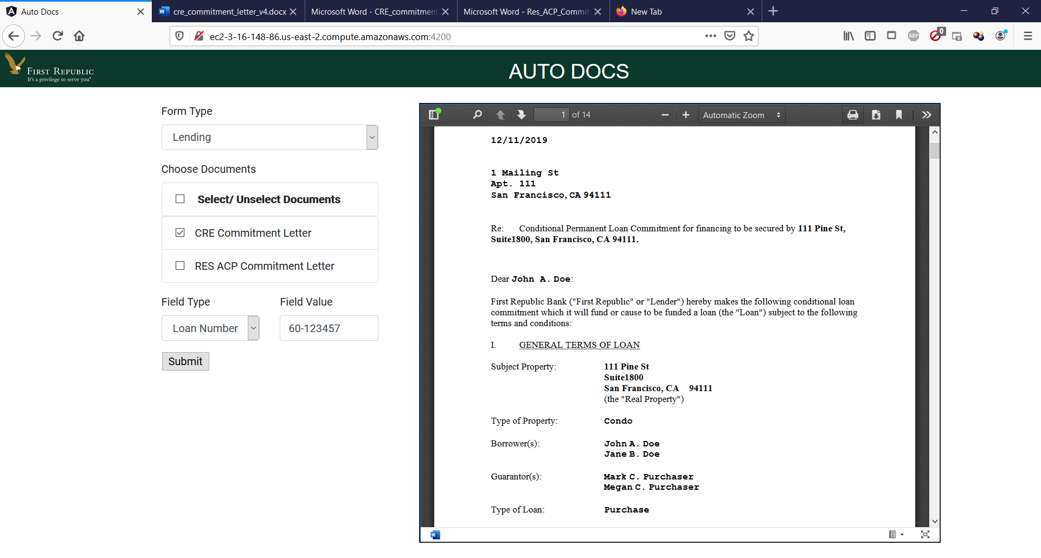
AutoDocs - Demo

Slide 6

AutoDocs - Key Benefits
Automate document upload to ON-BASE
Scale across large volume of data quickly and efficiently
Improve data quality and accuracy
Alleviate manual effort to search data across multiple interfaces
Alleviate human errors from typos
Securely share documents amongst authorized individuals
Expose an API to other apps/processes and return completed documents

Slide 7


AutoDocs - Solution and Enhancements
Auto Docs
Processor
(UI + Processing)
1 – Select Form Type
2 – Select key-value data to be searched viz. SSN, Loan # etc.
FRB Business Users
Store finished documents
Collaborate
(Template Documents)
Template documents
AWS S3
(Documents
storage)
Aggregated Data
Store finished documents
ON BASE
(Transformed Documents)
FRB
Data Source 1
Populate Data
Expose an API
FRB
Data Source 2
FRB
Data Source 3
Demo components
Envisioned for target state

